Slide 1
Classification Using Logistic Regression
By - Ravi

Slide 2
Why Classification ?
Classification is a very common and important variant among Machine Learning Problems. Many Machine Algorithms have been framed to tackle classification (discrete not continuous) problems. Examples of classification based predictive analytics problems are:
Diabetic Retinopathy: Given a retinal image, classify the image (eye) as Diabetic or Non-Diabetic.
Sentiment Analysis: Given a sentence, analyze the sense of the sentence (for ex. happiness/sadness, praise/insult, etc.)
Digit Recognition: Given an image of a digit, recognize the digit (0–9). This is an example of Multi-Class Classification.

Slide 3
Why Classification ?
Problems 1 and 2 are examples of Binary Classification, where there are only 2 classes, Diabetic / Non-Diabetic and Happiness / Sadness or Praise / Insult respectively. But Problem 3 has 10 classes as there are 10 digits (0–9). So it requires Multi-Class Classification.
Among many Machine Learning Classification Algorithms, Logistic Regression is one of the widely used and very popular one. It can be used in both Binary and Multi-Class Classification Problems.

Slide 4
Comparison to Linear Regression
Given data on time spent studying and exam scores. Linear Regression and logistic regression can predict different things:
Linear Regression could help us predict the student’s test score on a scale of 0 - 100. Linear regression predictions are continuous (numbers in a range).
Logistic Regression could help use predict whether the student passed or failed. Logistic regression predictions are discrete (only specific values or categories are allowed). We can also view probability scores underlying the model’s classifications.

Slide 5

Let's start from how not to do things. In classification problems, linear regression performs very poorly and when it works it's usually a stroke of luck. The main reason is that in classification, unlike in regression, you don't have to choose the best line through a set of points, but rather you want to somehow separate those points.

Slide 6
Logistic Regression
Logistic regression is a generalized linear model (GLM) that we can use to model or predict categorical outcome variables. For example, we might use logistic regression to predict whether someone will be denied or approved for a loan, but probably not to predict the value of someone’s house.
In logistic regression, we’re essentially trying to find the weights that maximize the likelihood of producing our given data and use them to categorize the response variable. Maximum Likelihood Estimation is a well covered topic in statistics

Slide 7
Logistic Regression
As the name “Logistic”, makes us think that there might be a function known as Logistic which is involved in the hypothesis of the Machine Learning Algorithm.
Hypothesis - In science, a hypothesis is an idea or explanation that you then test through study and experimentation. Outside science, a theory or guess can also be called a hypothesis. A hypothesis is something more than a wild guess but less than a well-established theory.
Say for example that you are playing with image recognition: given a bunch of photos of bananas, you want to tell whether they are ripe or not, given the color. You collect the data and plot it.

Slide 8
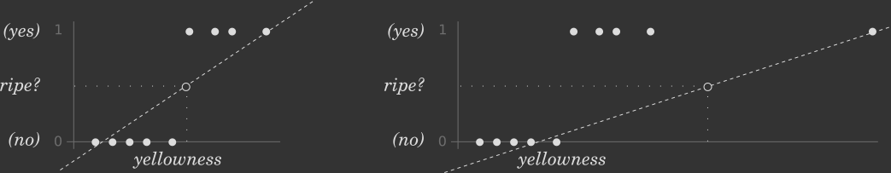
Logistic Regression
First attempt to handle a classification problem with linear regression. Outliers distort the hypothesis line.
Every white dot is an element in the training set, after the linear regression algorithm has been run on it, you end up with the well-known hypothesis function, depicted by the dashed line.

Slide 9

Logistic regression to the rescue
Logistic regression is a more performant algorithm used in classification problems. The most important feature is its ability to produce a sort of hard-limited hypothesis function:

Slide 10
Types of logistic regression
Binary (Pass/Fail)
Multi (Cats, Dogs, Sheep)
Ordinal (Low, Medium, High)

Slide 11
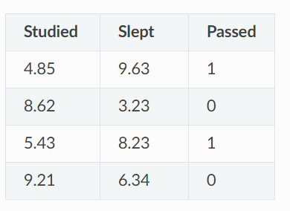
Binary logistic regression
Say we’re given data on student exam results and our goal is to predict whether a student will pass or fail based on number of hours slept and hours spent studying. We have two features (hours slept, hours studied) and two classes: passed (1) and failed (0).

Slide 12
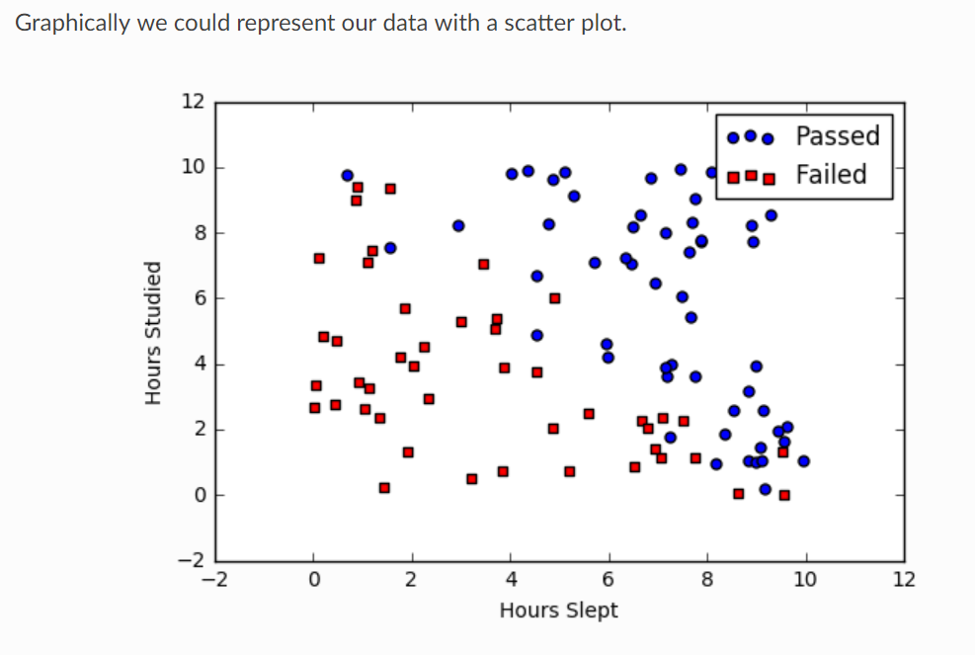

Slide 13
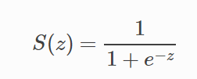
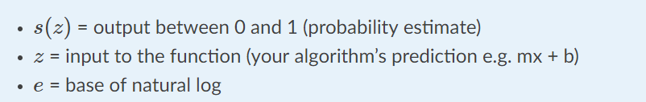
Sigmoid activation / Function
In order to map predicted values to probabilities, we use the sigmoid function. The function maps any real value into another value between 0 and 1. In machine learning, we use sigmoid to map predictions to probabilities.

Slide 14

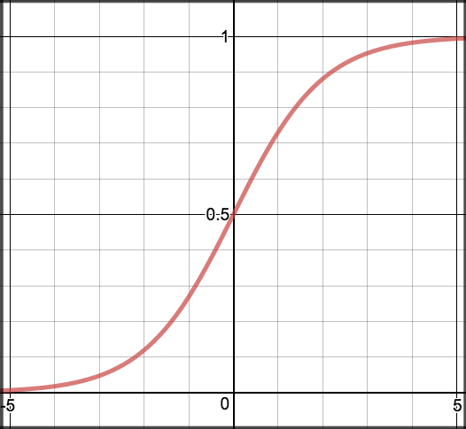
Now, moving on to the hypothesis of Logistic Regression:

Slide 15

Decision boundary
Our current prediction function returns a probability score between 0 and 1. In order to map this to a discrete class (true/false, cat/dog), we select a threshold value or tipping point above which we will classify values into class 1 and below which we classify values into class 2.
For example, if our threshold was 0.5 and our prediction function returned .7, we would classify this observation as positive. If our prediction was 0.2 we would classify the observation as negative. For logistic regression with multiple classes we could select the class with the highest predicted probability.

Slide 16
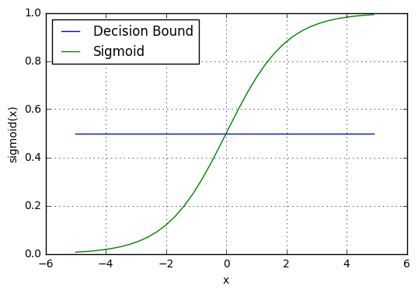
Decision boundary

Slide 17
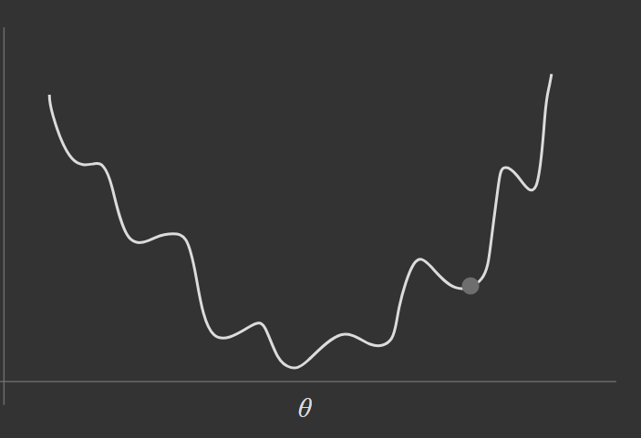
Logistic Regression Cost Function
Unfortunately we can’t (or at least shouldn’t) use the same cost function MSE as we did for linear regression. Because our prediction function is non-linear (due to sigmoid transform). Squaring this prediction as we do in MSE results in a non-convex function with many local minimums. If our cost function has many local minimums, gradient descent may not find the optimal global minimum.

Slide 18
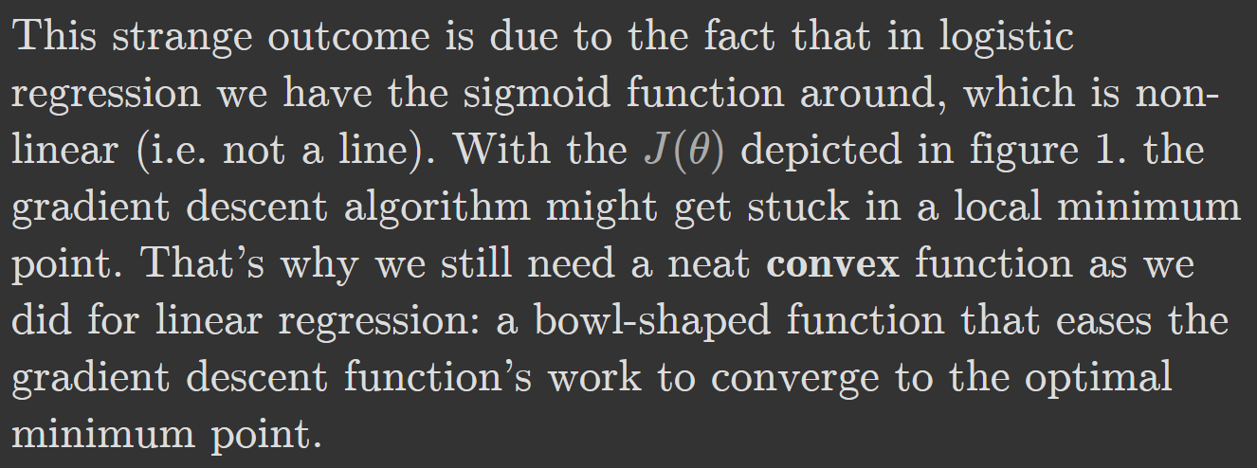

Slide 19
Maximum Likelihood Estimation
In statistics, maximum likelihood estimation (MLE) is a method of estimating the parameters of a statistical model, given observations. MLE attempts to find the parameter values that maximize the likelihood function, given the observations. The resulting estimate is called a maximum likelihood estimate, which is also abbreviated as MLE.
To Understand this let’s take a example :
We have only 4 points- 2 positive and 2 negative, and two random lines – one that classifies two points correctly and two incorrectly, and the other that classifies all 4 points correctly.

Slide 20
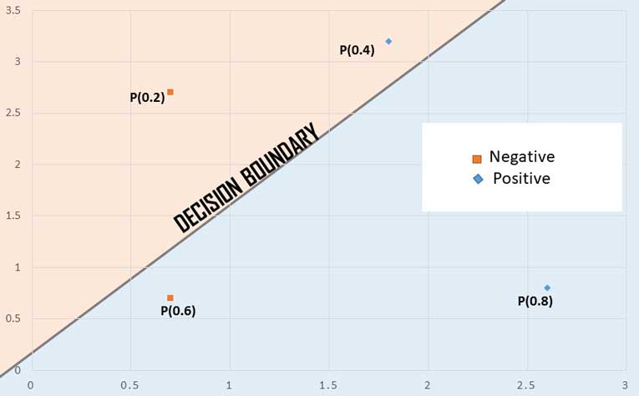
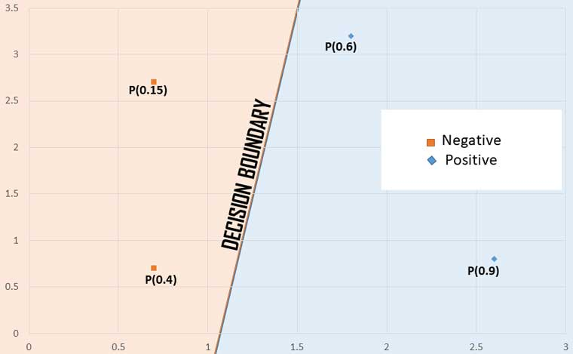
Maximum Likelihood Estimation
Decision boundary classifies 2 points correctly and 2 incorrectly.
Decision boundary classifies all points correctly.

Slide 21
Maximum Likelihood Estimation
Likelihood of a system is calculated as the product of probability being positive for all blue points multiplied with product of probability being negative for all red points.
Likelihood of true values in case 1 (LHS) = 0.8 * 0.4 * (1 – 0.6) * (1 – 0.2) = 0.1024
Likelihood of true values in case 2 (RHS) = 0.6 * 0.9 * (1 – 0.15) * (1 – 0.4) = 0.2754
It is clear that case 2 has better score than case 1. But multiplication of probabilities. That’s scary!!!!

Slide 22

Maximum Likelihood Estimation
Luckily, we have our log function at our side.
We know that
Since log of numbers between 0 and 1 is negative, we add a negative sign to find the log-likelihood.
-log(likelihood) = -(-1.287) = 1.287

Slide 23
Maximum Likelihood Estimation
This is what we call cross-entropy. Since we have added a negative sign ahead of the log-likelihood, it is clear that minimizing cross-entropy is similar to maximizing likelihood of the model! That’s what we just needed, a thing to call a loss function!
Let’s right down general formula of cross-entropy for a binary classifier:

Slide 24
Maximum Likelihood Estimation
m: Number of examples
y_{hat}: Predicted probability of being positive
y: True value (1 – Positive; 0 – Negative)
So, we are computing mean of something, that is clear from the sum of m terms divided by m.

Slide 25
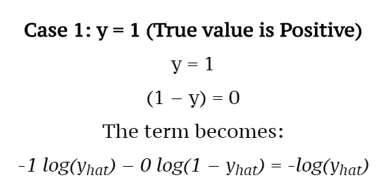
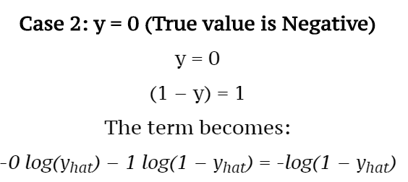
How It Works ?
Let’s look at the solution to one term out of all m terms:

Slide 26
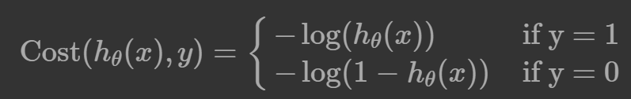
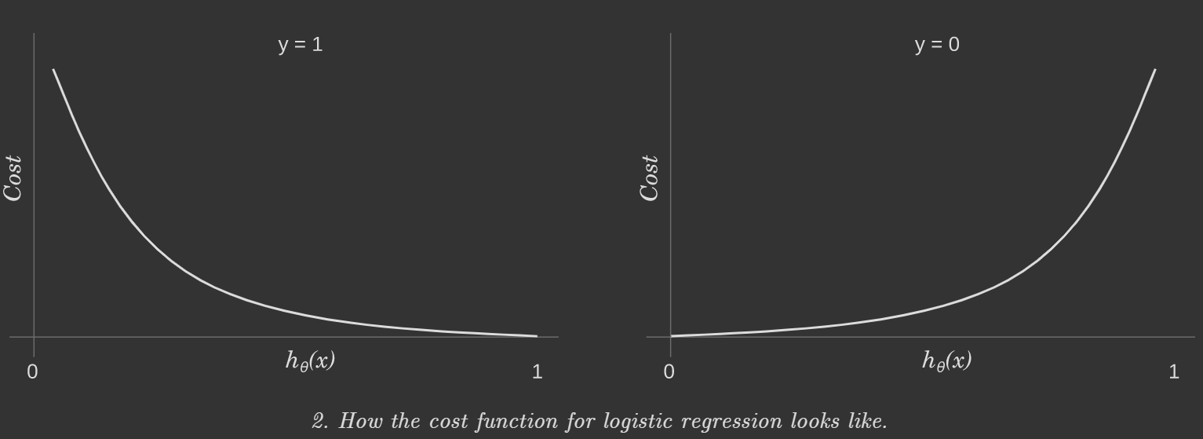
Logistic Regression Cost Function

